Slide 1
Presentation On Computer Networking
INTRODUCTION TO COMPUTER NETWORKING
Definition: Computer networking is the practice of connecting computers and other devices together to share resources and information.
Importance: Facilitates communication, resource sharing, collaboration, and data transfer.
Evolution: From early local area networks (LANs) to the internet and beyond.

Slide 2
COMPONENTS OF NWTWORKING
Devices:
Computers, servers, routers, switches, modems, etc.
Media:
Cables (Ethernet, Fiber optic), wireless (Wi-Fi, Bluetooth), satellite, etc.
Protocols:
TCP/IP, HTTP, FTP, SMTP, DNS, etc.

Slide 3
Types of Computer Networking
Based on Geographical Scope:
a. Local Area Network (LAN)
b. Metropolitan Area Network (MAN)
c. Wide Area Network (WAN)
d. Personal Area Network (PAN)
2. Based on Connection Method:
Wired Networking
b. Wireless Networking
3. Based on Functional Relationship:
Client-Server Network
b. Peer-to-Peer Network

Slide 4
NETWORK TOPOLOGIES
Bus Topology: All devices are connected to a central cable, forming a single pathway.
Star Topology: All devices are connected to a central hub or switch.
Ring Topology: Each device is connected to two other devices, forming a closed loop.
Mesh Topology: Devices are interconnected with multiple paths, offering redundancy and fault tolerance.

Slide 5
INTERNET AND ARPANET
ARPANET Characteristics
Packet Switching: Data transmission was broken down into packets, which could travel through different routes to reach the destination, ensuring robustness.
Network Control Protocol (NCP): The initial protocol used for communication between computers on ARPANET.
Limited Network Nodes: Initially, ARPANET connected only a few universities and research institutions.
Expansion and Evolution
ARPANET grew rapidly, connecting more universities and research centers across the United States.
Introduction of TCP/IP: In the 1970s, TCP/IP (Transmission Control Protocol/Internet Protocol) became the standard protocol suite, paving the way for the modern internet.
Birth of Email: ARPANET introduced email as a method of communication between users.

Slide 6
Introduction to the Internet
Introduction to the Internet
Definition: The internet is a global network of interconnected computers and other devices, enabling communication and information sharing across geographical boundaries.
Key Components of the Internet
Infrastructure:
Physical components such as servers, routers, switches, and cables.
Protocols:
TCP/IP (Transmission Control Protocol/Internet Protocol) serves as the foundation for data transmission and addressing.
Services:
Websites, email, social media, online gaming, streaming platforms, etc.
How the Internet Works
Data Transmission: Information is broken down into packets, routed through various network devices, and reassembled at the destination.
Client-Server Model: Clients (such as web browsers) request resources or services from servers (hosting websites or applications).

Slide 7
INTRODUCTION TO PACKETS
Introduction to Packets
Definition: Packets are small units of data that carry information across computer networks.
Purpose: Efficient transmission of data by breaking it into manageable chunks.
Analogy: Compare packets to envelopes containing letters in postal mail.
Slide 3: Components of a Packet
Header:
Contains control information such as source and destination addresses, sequence numbers, and error-checking codes.
Payload:
Actual data being transmitted, such as a portion of a file, email message, or webpage.
Trailer:
May include error-checking information like a cyclic redundancy check (CRC) to ensure data integrity.

Slide 8
BROADCAST, UNICAST AND MULTICAST
Introduction
In computer networking, data communication can occur through different methods, including broadcast, unicast, and multicast.
Each method serves specific purposes and has distinct characteristics.
Broadcast Communication
Definition: Broadcast communication involves sending data from one sender to all devices within the network.
Characteristics:
One-to-All Communication: Data is transmitted to all devices on the network.
No Addressing: No specific recipient address is used; the data is simply broadcasted to all devices.
Example: ARP (Address Resolution Protocol) broadcasts to resolve IP addresses to MAC addresses in a local network.

Slide 9
UNICAST
Unicast Communication
Definition: Unicast communication involves sending data from one sender to a specific recipient.
Characteristics:
One-to-One Communication: Data is transmitted from a single sender to a single recipient.
Addressing: Each packet is addressed to the specific IP addre

Slide 10
MULTICAST
Multicast Communication
Definition: Multicast communication involves sending data from one sender to multiple recipients who have expressed interest in receiving the data.
Characteristics:
One-to-Many Communication: Data is transmitted from one sender to a select group of recipients.
Group Addressing: Recipients subscribe to a multicast group address to receive the data.
Example: Video streaming applications where multiple users watch the same live stream simultaneously.

Slide 11
COMPARISION
Comparison
Broadcast:
Sends data to all devices on the network.
No addressing of specific recipients.
Used for certain network protocols and operations.
Unicast:
Sends data from one sender to one specific recipient.
Uses recipient's IP address for addressing.
Commonly used for most network communication.
Multicast:
Sends data from one sender to multiple recipients.
Uses multicast group addresses for addressing.
Efficient for distributing data to multiple interested parties.

Slide 12
Advantages and Considerations
Advantages and Considerations
Broadcast:
Simplicity in implementation.
Resource-intensive due to sending data to all devices.
Unicast:
Efficient for one-to-one communication.
Resource-friendly but may result in network congestion with numerous individual connections.
Multicast:
Efficient use of network resources.
Requires support from network infrastructure and devices.

Slide 13
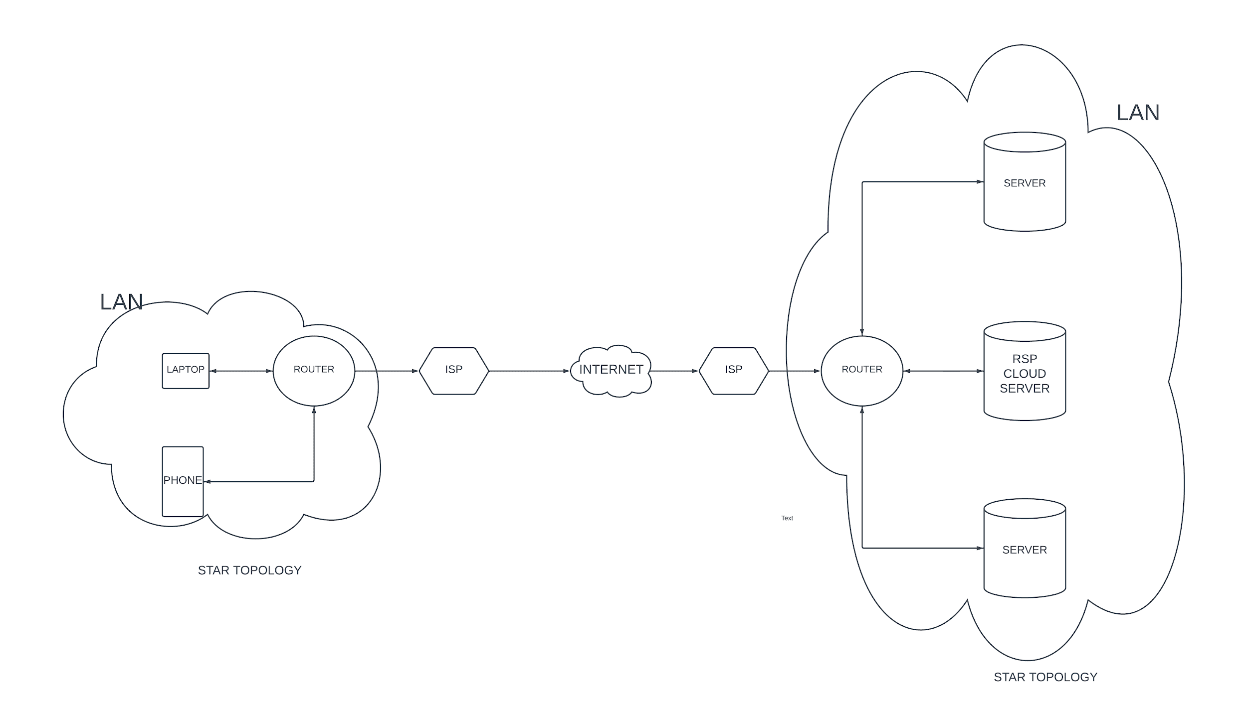
Home network topology with rps lab

Slide 14
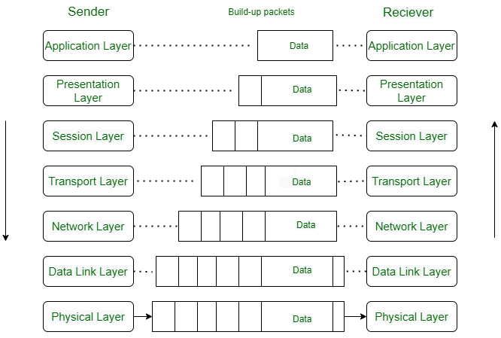
7 layer OSI diagram

Slide 15
THANK YOU
S.SAI MANASA

